Slide 1
Relational Database Design
Lecturer: Ngo Huy Bien
Software Engineering Department
Faculty of Information Technology
VNUHCM - University of Science
Ho Chi Minh City, Vietnam
nhbien@fit.hcmus.edu.vn

Slide 2

Objectives

Slide 3

Contents

Slide 4

References
Adam Jorgensen et al. (2012). Microsoft SQL Server 2012 Bible. Wiley.
Edgar E Codd (1990). The Relational Model for Database Management.

Slide 5
Tables, Rows, Columns [1]
A relational database collects related, or common, data in a single list.
A table appears similar to a spreadsheet and is constructed of columns and rows.
Whereas a spreadsheet tends to be free-flowing and loose in its design, database tables should be very consistent in terms of the meaning of the data in a column.

Slide 6
Comparing Database Terms
Development Style | List of Common Items | Item in the List | Piece of Information in the List
Legacy software | File | Record | Field
Spreadsheet | Spreadsheet/worksheet/named range | Row | Column/ cell
Relational algebra/ logical design | Entity, or relation | Tuple (rhymes with couple) | Attribute
SQL DDL design | Table | Row | Column
Object-oriented design | Class | Object instance | Property

Slide 7
Primary Keys
Perhaps the most important concept of an entity (table) is that it has a primary key — an attribute or set of attributes that can be used to uniquely identify the tuple (row).
Every entity must have a primary key; without a primary key, it’s not a valid entity.
By definition, a primary key must be unique and must have a value (not null).

Slide 8
Foreign Keys
When two entities (tables) relate to one another, one entity is typically the primary entity and the other entity is the secondary entity.
The connection between the two entities is made by replicating the primary key from the primary entity in the secondary entity.
The duplicated attributes in the secondary entity are known as a foreign key.
Informally this type of relationship is sometimes called a parent-child relationship.

Slide 9


Slide 10
Why Normalization?
The primary purpose of normalization is to improve the data integrity of the database by reducing or eliminating modification anomalies that can occur when the same fact is stored in multiple locations within the database.
Duplicate data raises all sorts of interesting problems for inserts, updates, and deletes. For example, if the product name is stored in the order detail table, and the product name is edited, should every order details row be updated?

Slide 11
The Three “Rules of One”
The key to designing a schema that avoids update anomalies is to ensure that each single fact in real life is modeled by a single data point in the database.
Three principles define a single data point:
One group of similar things is represented by one entity (table).
One thing is represented by one tuple (row).
One descriptive fact about the thing is represented by one attribute (column).

Slide 12
First Normal Form (1NF)
The first normalized form means the data is in an entity format, such that the following three conditions are met:
Every unit of data is represented within scalar attributes. A scalar value is a value “capable of being represented by a point on a scale”.
All data must be represented in unique attributes. Each attribute must have a unique name and a unique purpose.
All data must be represented within unique tuples. If the entity design requires or permits duplicate tuples, that design violates the first normal form.

Slide 13
The First Normal Form Violation
You have a listing of customers and each customer can have multiple phone numbers.
Each customer corresponds to a "repeating group" of phone number (second rule violation).
Customer | PhoneNumber
John Doe | 111 111 1111, 222 222 2222
Jane Smith | 333 333 3333, 444 444 4444
Luke Phillips | 555 555 5555

Slide 14
Fix 1NF Violation
To redesign the data model so that it complies with the first normal form, resolve the repeating group of phone number attributes into a single unique attribute.
PhoneNumber Entity |  | CustomerEntity
CustomerID (FK) | PhoneNumber | CustomerID (PK) | Name
1 | 111 111 1111 | 1 | John Doe
1 | 222 222 2222 | 2 | Jane Smith
2 | 333 333 3333 | 3 | Luke Phillips
2 | 444 444 4444
3 | 555 555 5555

Slide 15
Second Normal Form (2NF)
The second normal form ensures that each attribute describes the entity. It’s a dependency issue.
Does the attribute depend on, or describe, the item identified by the primary key?
If the entity’s primary key is a single value, this isn’t too difficult.
Composite primary keys can sometimes get into trouble with the second normal form if the attributes aren’t dependent on every attribute in the primary key.

Slide 16
The Second Normal Form Violation
Assume a database contains the table RegionalOfficeStore, whose primary key was a composite key including RegionalOfficeID and StoreID.
Adding the regional phone number to the data model would violate the second normal form.
Because the primary key (PK) is a composite of both RegionalOffice and Store, and that the phone number is a permanent phone number for the regional office, a phone number isn’t assigned for each store.
PK-RegionalOffice | PK-Store | RegionalOffice PhoneNumber
Southeast | Store One | 828-555-1212
Southeast | Store Two | 828-555-1212
North | Store Three | 828-555-1213

Slide 17
Conform to the 2NF
The solution is to remove the partially dependent attribute from the entity with the composite keys, and create an entity with a unique primary key for the store.
This new entity is then an appropriate location for the dependent attribute.
Store Entity |  | Regional Office Entity
PK-RegionalOffice | PK-Store | PK-RegionalOffice | PPhoneNumber
Southeast | Store One | Southeast | 828-555-1212
Southeast | Store Two | North | 828-555-1213
North | Store Three
North | Store Four

Slide 18
Third Normal Form (3NF)
The third normal form checks for transitive dependencies.
A transitive dependency is similar to a partial dependency in that they both refer to attributes that are not fully dependent on a primary key.
A dependency is transient when attribute1 is dependent on attribute2, which is dependent on the primary key.

Slide 19
Violating the Third Normal Form
The DateofHire describes the manager not the region, so the hire-date attribute is not directly dependent on the RegionalOffice entity’s primary key.
The DateOfHire’s dependency is transitive — it describes the key and a non-key attribute — in that it goes through the Manager attribute.
Regional Office Entity
RegionalOfficePK | RegionalOfficePhoneNumber | LManager | DateofHire
Southeast | 1-828-555-1212 | Jeff Davis | 5/1/99
North | 1-828-555-1213 | Ken Frank | 4/15/97
Northwest | 1-828-555-1214 | Dab Smith | 7/7/2001

Slide 20
Conforming to the 3NF
Creating a Manager entity and moving its attributes to the new entity resolves the violation of the third normal form
Regional Office Entity |  | Manager Entity
RegionalOfficePK | Manager | ManagerPK | DateofHire
Southeast | Jeff Davis | Jeff Davis | 5/1/99
North | Ken Frank | Ken Frank | 4/15/97
Northwest | Dab Smith | Dab Smith | 7/7/2001

Slide 22
Database Design Phases
Traditionally, data modeling has been split into two phases:
the logical design (Conceptual Model, i.e. ERD) and
the physical design (SQL DDL Layer & Physical Layer).
However, after spending countless hours designing relation databases and listening to several lectures on database design the authors are convinced that there are three phases to database design.
Conceptual model
SQL DDL Layer
Physical Layer
See the next Slides for details.

Slide 23
Conceptual Model
The first phase digests the organizational requirements and identifies the entities, their attributes, and their relationships.
The conceptual diagram model is great for understanding, communicating, and verifying the organization’s requirements.
Visio or some similar diagramming tool can assist to provide a visual aspect to the conceptual model.
At this layer, the design is implementation-independent: It could end up on Oracle, SQL Server, or even Access.

Slide 24
SQL DDL Layer
This phase concentrates on performance without losing the fidelity of the logical model as it applies the design to a specific version of a database engine — SQL Server 2012, for example, generating the DDL for the actual tables, keys, and attributes.
Typically, the SQL DDL Layer generalizes some entities and replaces some natural keys with surrogate computer-generated keys.
Typically, database developers realize the need for additional tables (entities) and their corresponding attributes and keys.
As a result, the SQL DDL layer might look different than the conceptual model.

Slide 25
Physical Layer
The implementation phase considers how the data will be physically stored on the disk subsystems using indexes, partitioning, and materialized views.
Changes made to this layer won’t affect how the data is accessed, only how it’s stored on the disk.
The physical layer ranges from simple, for small databases (under 20Gb), to complex, with multiple filegroups, indexed views, and data routing partitions.

Slide 26
Notes
Implementing a database without working through the SQL DLL Layer design phase is a certain path to a poorly performing database.
Many database purists didn’t care to learn SQL Server implement conceptual designs only to blame SQL Server for the horrible performance.

Slide 28
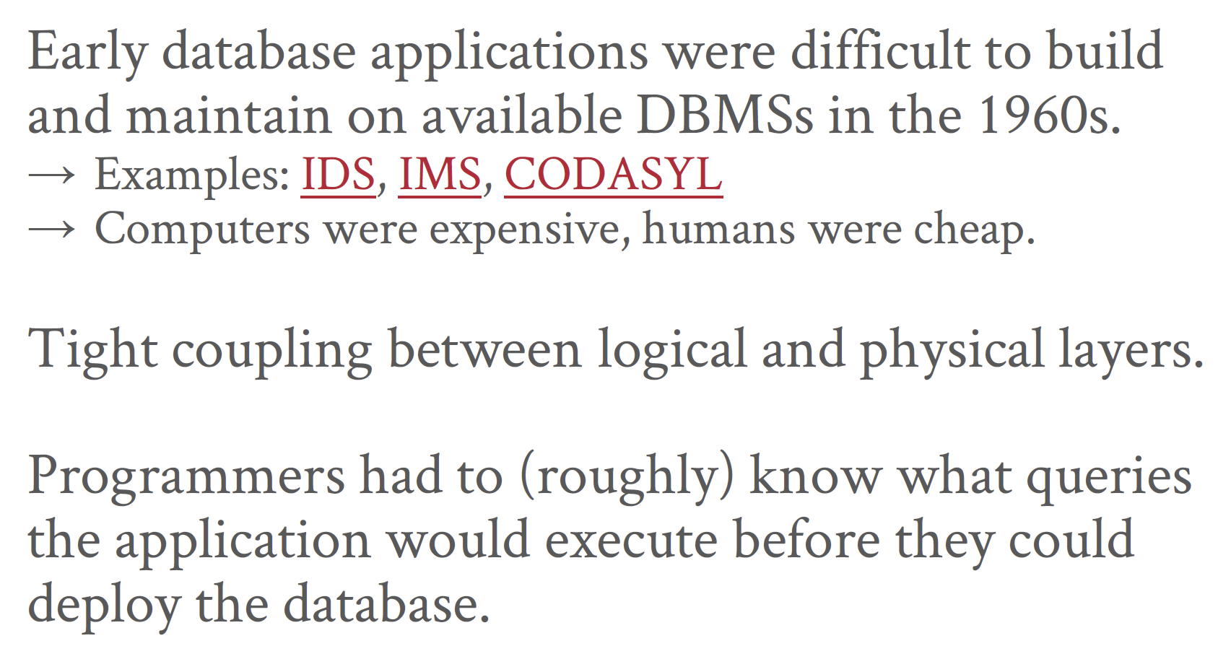
Early DBMSs

Slide 29
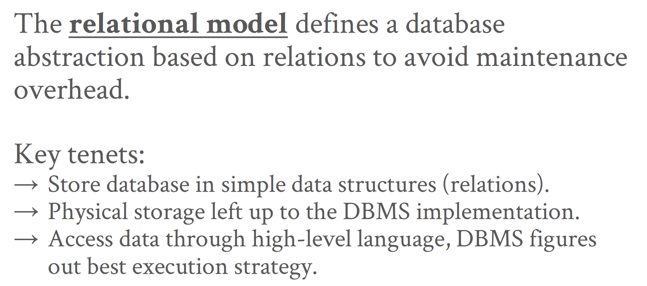
Relational Model Idea

Slide 30
Relational Model
Structure: The definition of the database’s relations and their contents independent of their physical representation.
Integrity: Ensure the database’s contents satisfy constraints.
Manipulation: Programming interface for accessing and modifying a database's contents.

Slide 31
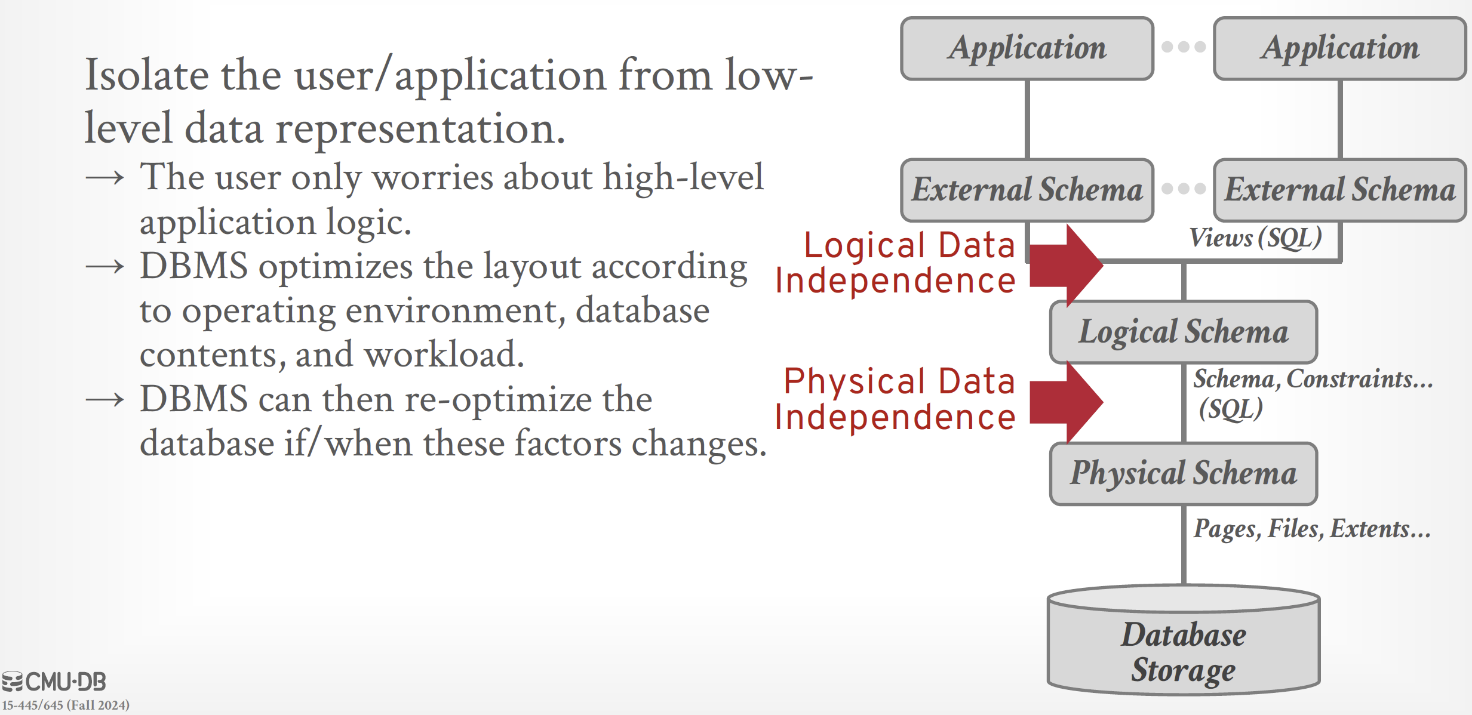
Data Independence

Slide 32
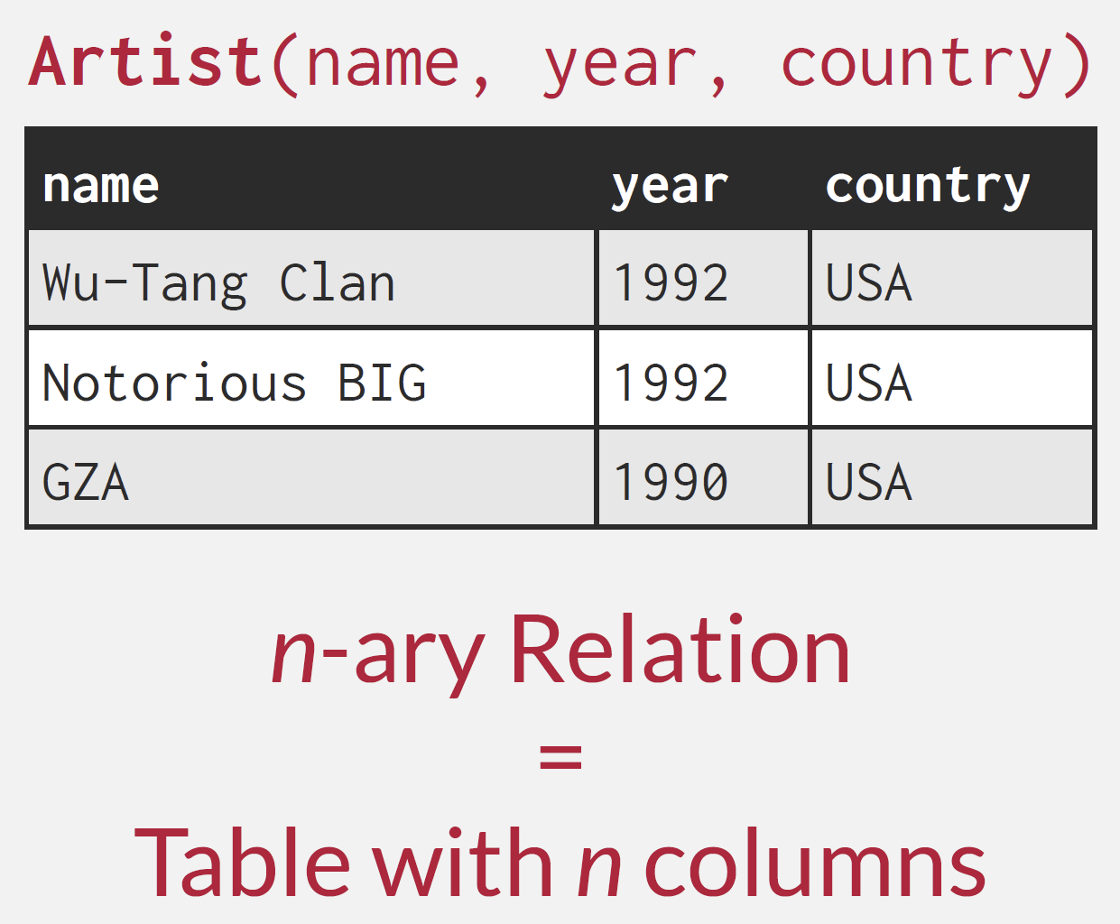
Relational Model: Relations & Tuples
A relation is an unordered set that contain the relationship of attributes that represent entities.
A tuple is a set of attribute values (also known as its domain) in the relation.
Values are (normally) atomic/scalar.
The special value NULL is a member of every domain (if allowed).

Slide 33
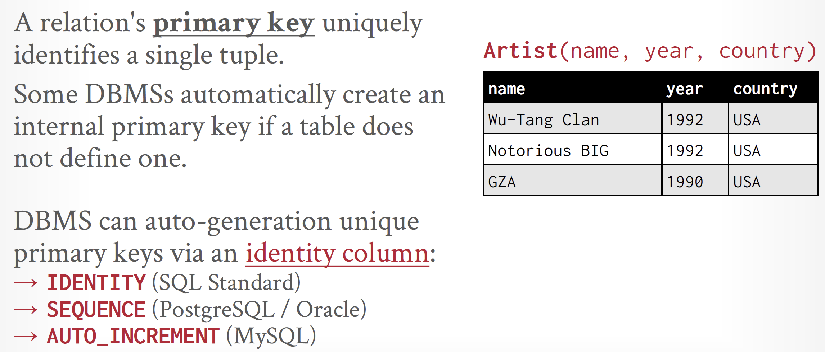
Relational Model: Primary Keys

Slide 34
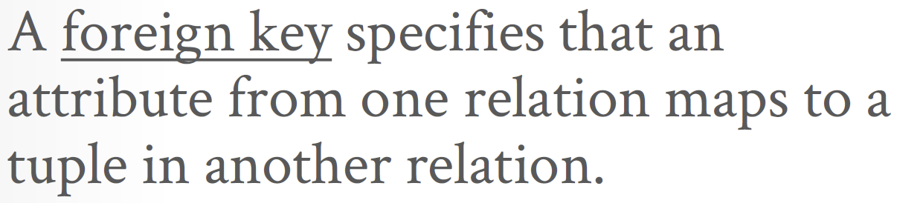
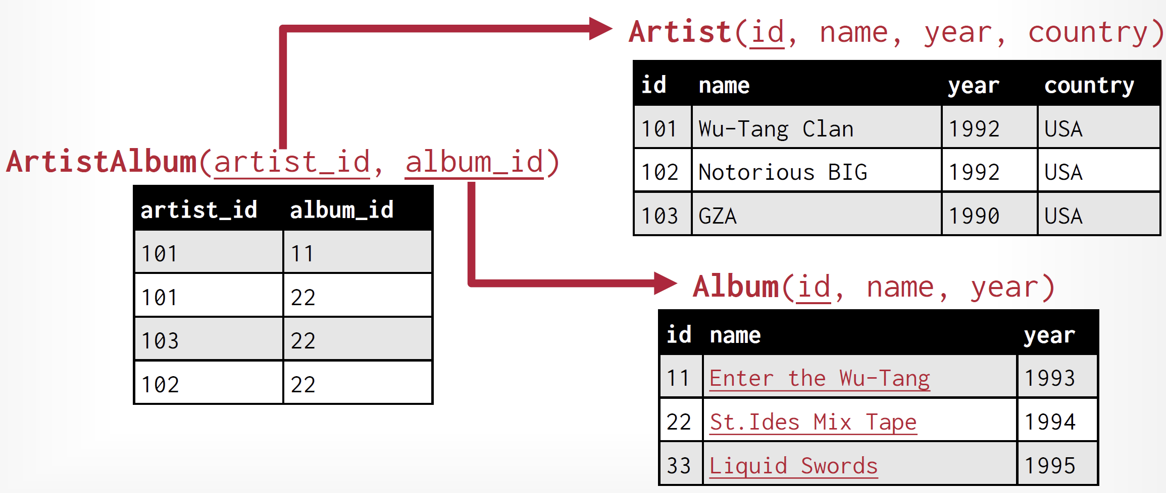
Relational Model: Foreign Keys

Slide 35
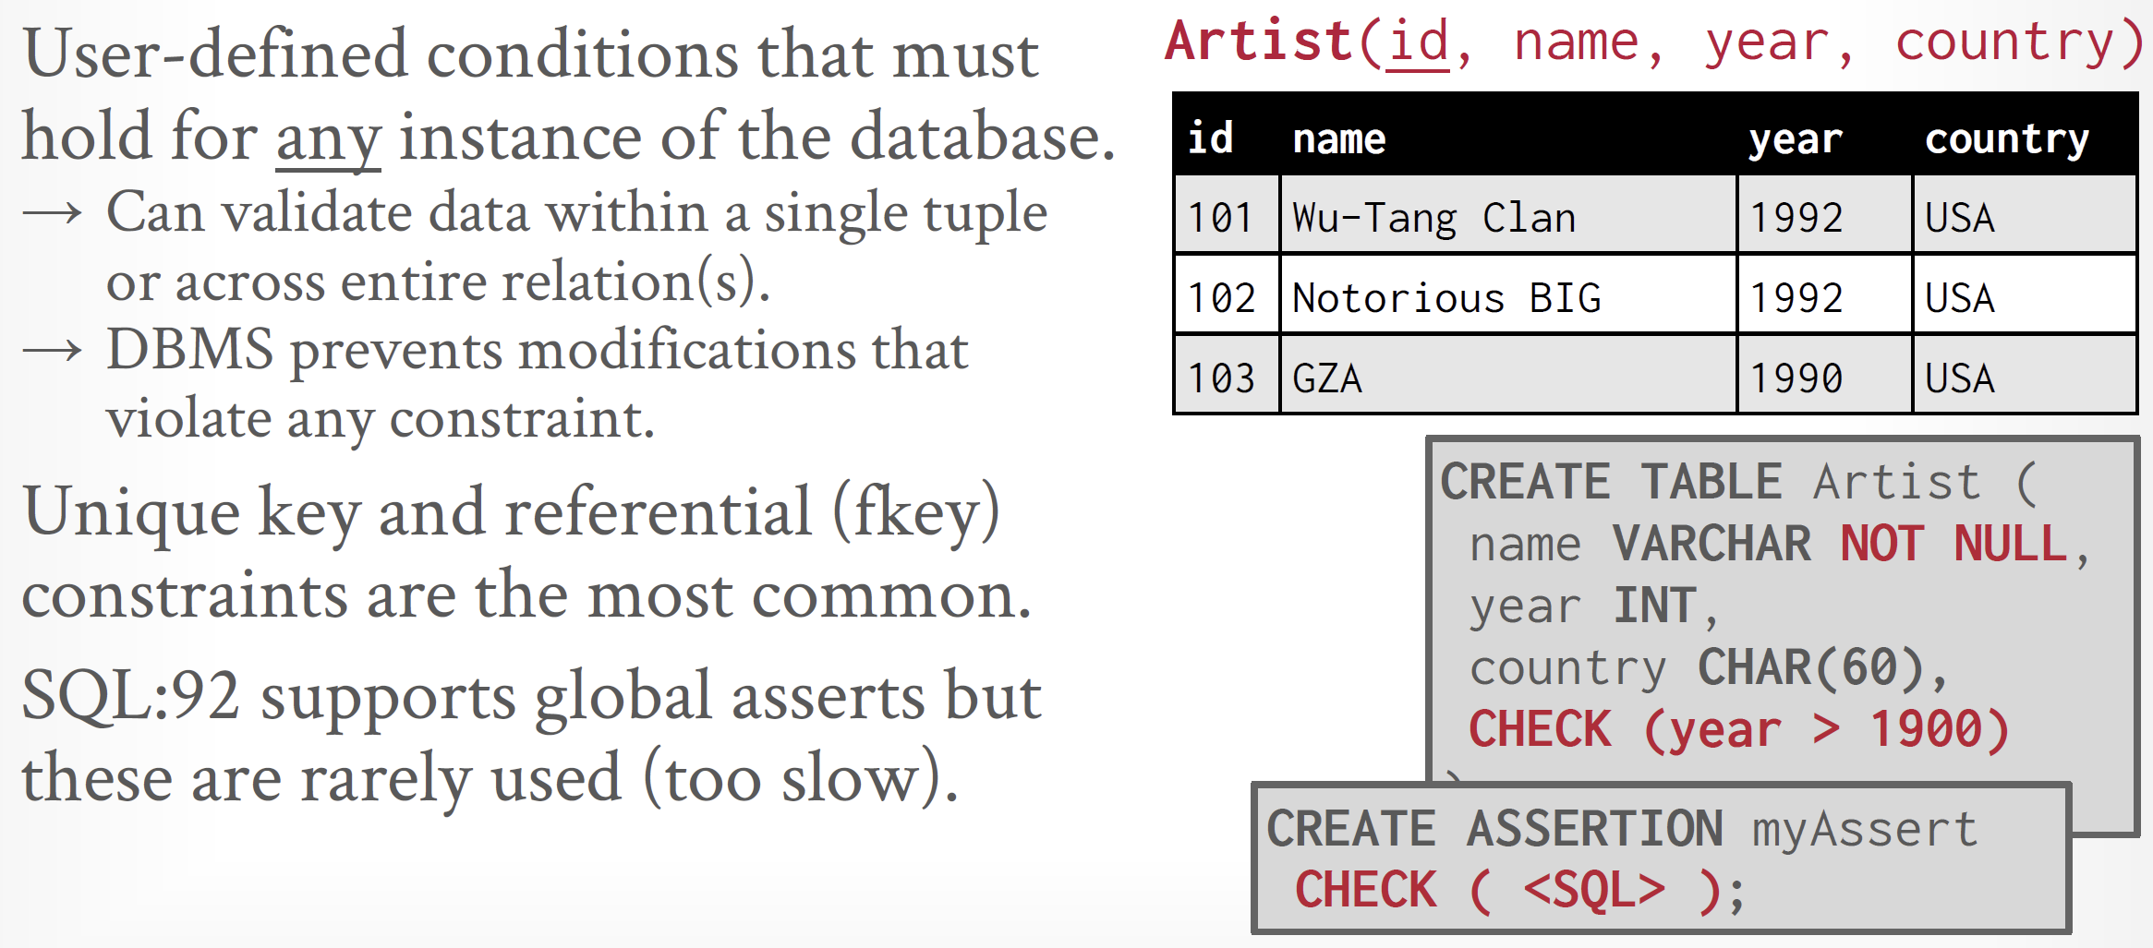
Relational Model: Constraints

Slide 36
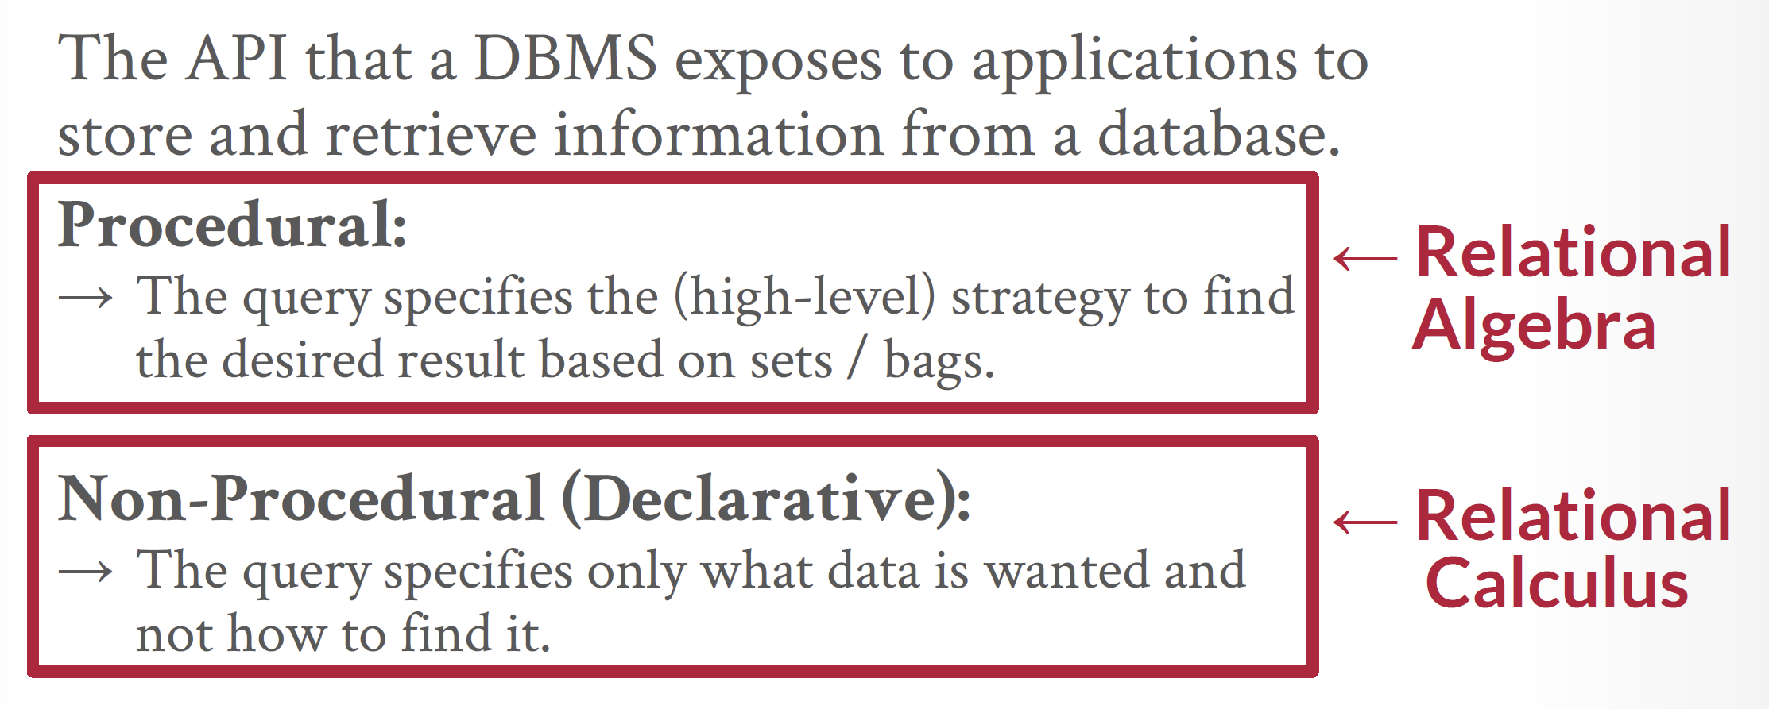
Data Manipulation Languages (DMLs)

Slide 37
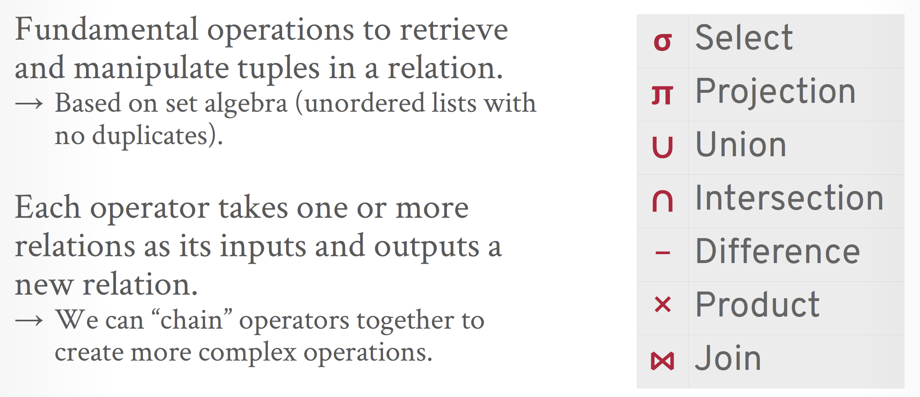
Relational Algebra

Slide 38
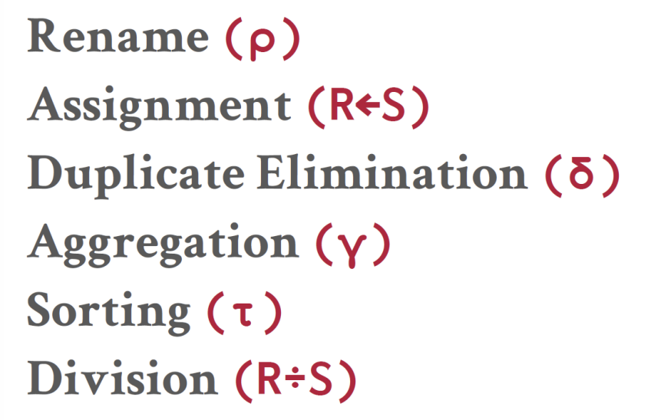
Relational Algebra: Extra Operators

Slide 39
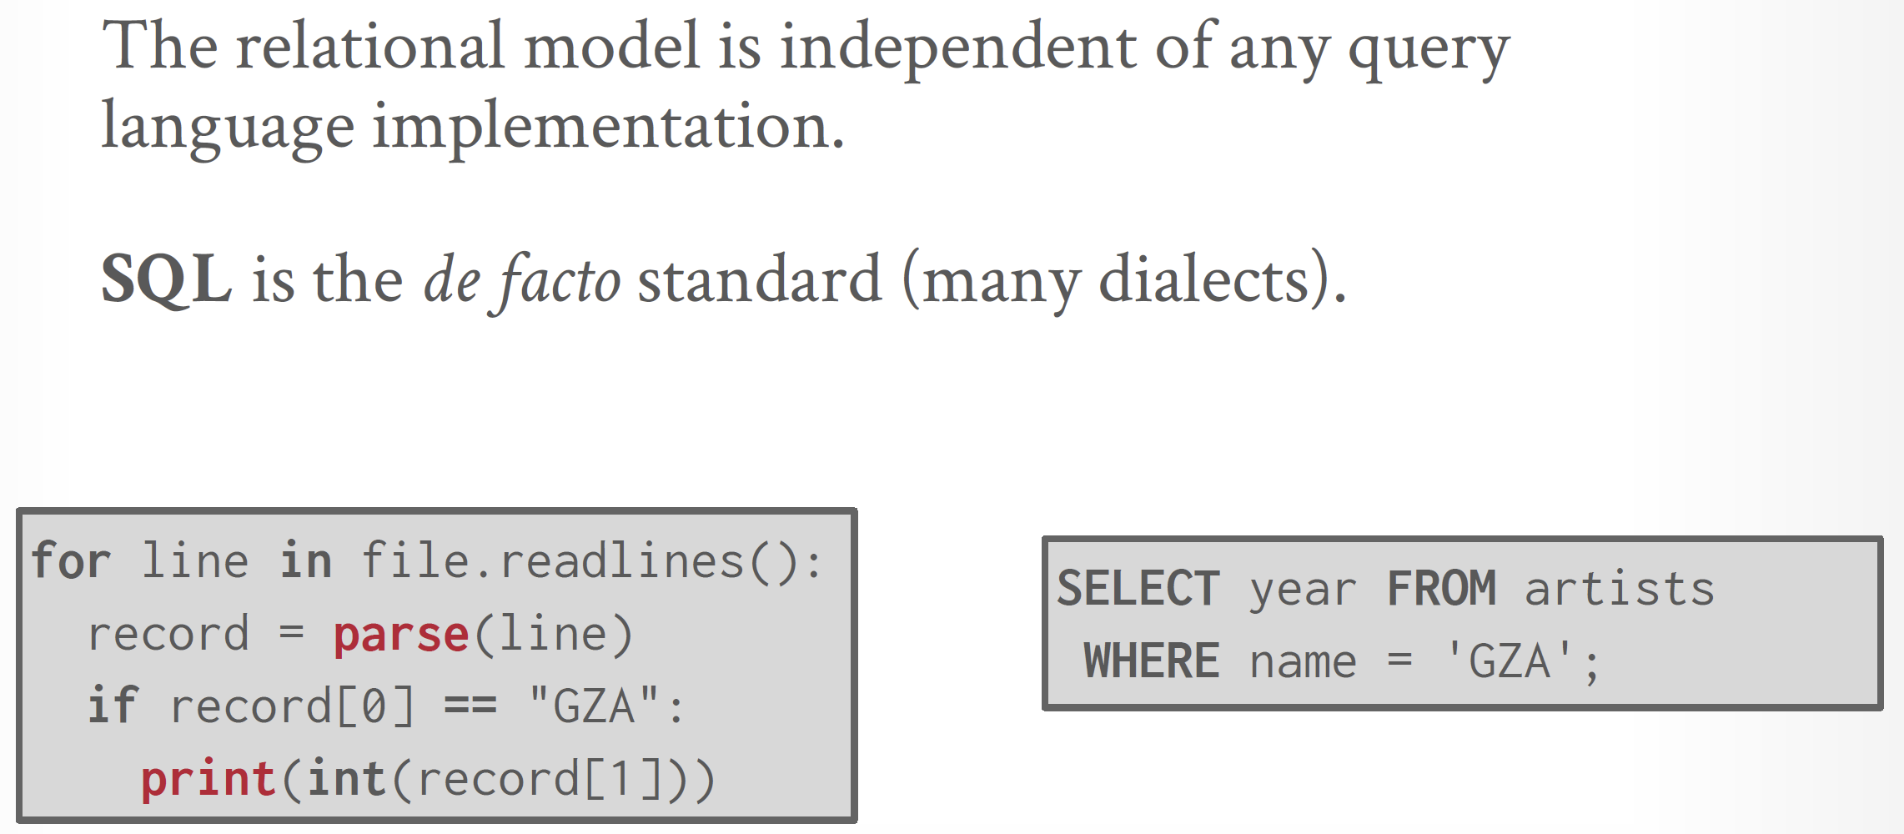
Relational Model: Queries

Slide 40
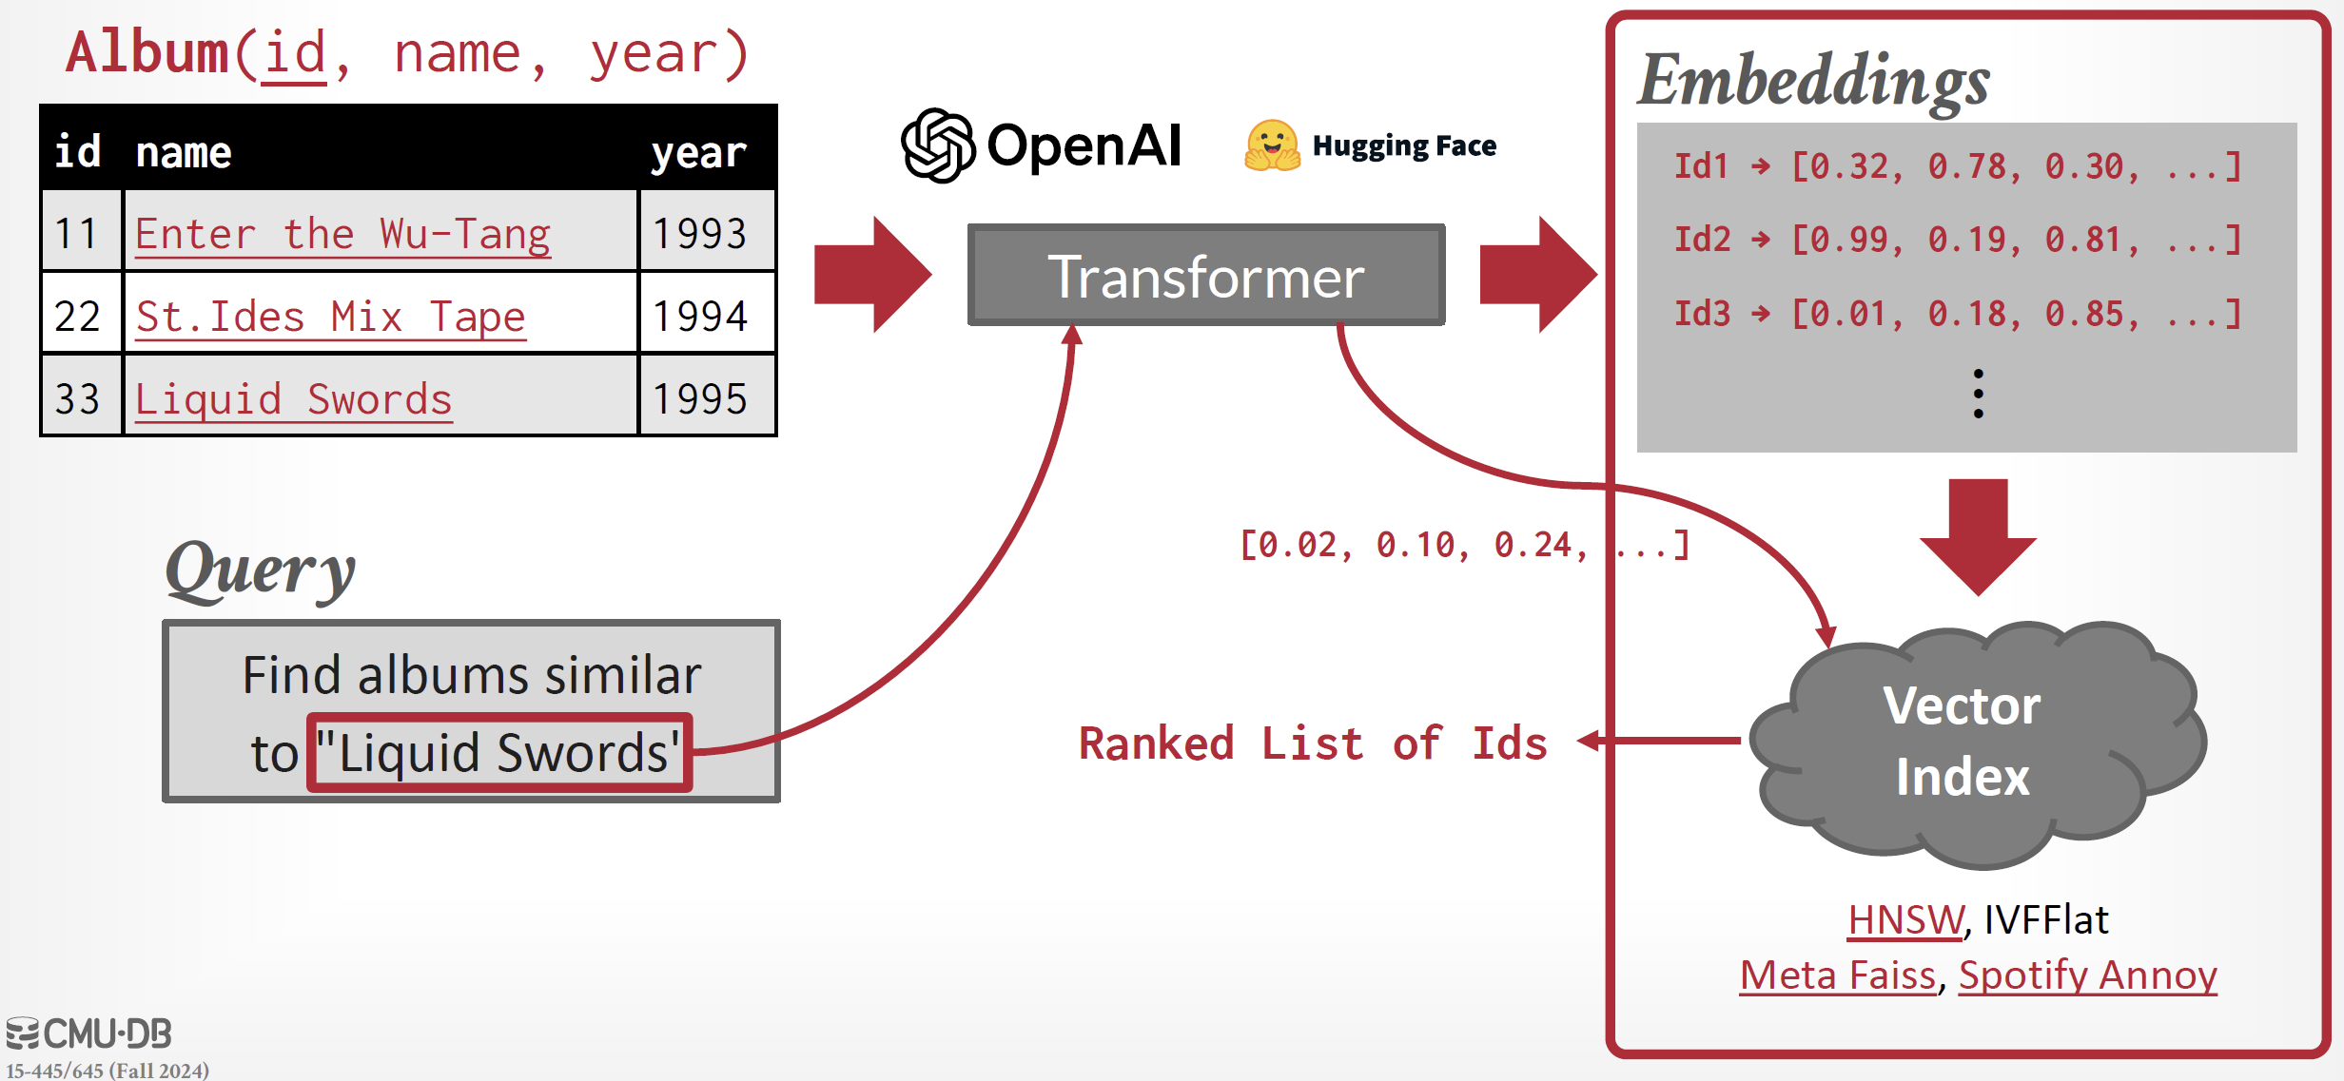
Vector Data Model

Slide 42
What is a Relation? [2]
Given sets S1, S2 , . . . , Sn (not necessarily distinct), R is a relation on these n sets if it is a set of n-tuples, the first component of which is drawn from S1, the second component from S2, and so on.
More concisely, R is a subset of the Cartesian product
S1 × S2 × . . . × Sn.
Relation R is said to be of degree n.
Each of the sets S1, S2, . . . , Sn on which one or more relations are defined is called a domain.

Slide 43
Notes
A mathematical relation is a set with special properties.
First, all of its elements are tuples, all of the same type.
Second, it is an unordered set.

Slide 44
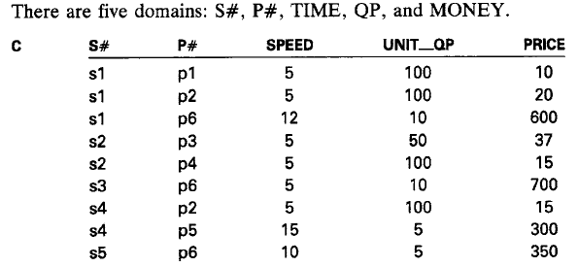
Properties of a Relation
When conceived as a table, R has the following properties:
each row represents a tuple of R;
the ordering of rows is immaterial;
all rows are distinct from one another in content.
All of the rows (nine in this example) constitute the extension of the capabilities relation C.
C: Providing information concerning which suppliers can supply which kinds of parts.

Slide 45
Terminology
Mathematical Term | Database Term
Relation of degree n | R-table with n columns
Attribute | Column of R-table
Domain | Extended data type
Tuple | Row of R-table
Cardinality of relation | Number of rows in R-table

Slide 46
The Relational Model
Database management involves the sharing of large quantities of data by many users – who, for the most part, conceive their actions on the data independently from one another.
The relational model can be construed as a highly disciplined approach to database management.
The fundamental principle in the relational model is that all inter-relating is achieved by means of comparisons of values, whether these values identify objects in the real world or whether they indicate properties of those objects.
A pair of values may be meaningfully compared, however, if and only if these values are drawn from a common domain.

Slide 47
Relational Database
A relational database is a collection of relations of assorted degrees.
All of the query and manipulative operators are upon relations, and all of them generate relations as results.
Relational databases that have many relations, each with few rows (tuples), are often called rich, while those that have few relations, each with many rows, are called large.
In the relational model there is only one type of compound data: the relation.

Slide 48
Entity-Relationship Approach Problems
Only the structural aspects were described; neither the operators upon these structures nor the integrity constraints were discussed. Therefore, it was not a data model.
The distinction between entities and relationships was not, and is still not, precisely defined.
Consequently, one person's entity is another person's relationship.
A good example is an airline flight.
An accountant is likely to think of this as an entity.
Someone responsible for airplane scheduling or crew scheduling is likely to think of it as a relationship between a type of aircraft, a flight route, a crew, and a date.
Even if this distinction had been precisely defined, it would have added complexity without adding power.

Slide 49
Role of Language in the Relational Model
The abbreviation RL denotes the principal relational language supported by the DBMS – a language intended specifically for database management, and one that is not guaranteed to be usable for the computation of all computable functions.
The complete power of RL should be fully exploitable in at least the following contexts:
retrieval (database description, contents, and audit log);
view definition;
insertion, update, and deletion;
handling missing information (independent of data type);
integrity constraints;
authorization constraints;
if the DBMS is claimed to be able to handle distributed data, distributed database management with distribution independence, including automatic decomposition of commands by the DBMS and automatic re-composition of results by the DBMS

Slide 50
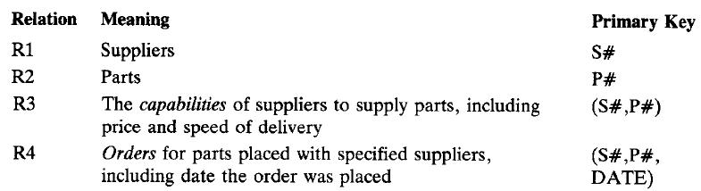
Primary Keys
Each base R-table has exactly one primary key.
This key is a combination of columns (possibly just one column) such that
the value of the primary key in each row of the pertinent R-table identifies that row uniquely (i.e., it distinguishes that row from every other row in that R-table);
if the primary key is composite and if one of the columns is dropped from the primary key, the first property is no longer guaranteed.

Slide 51
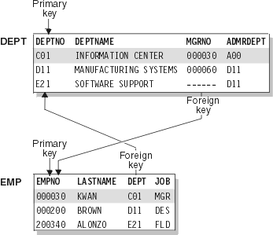
Foreign Key
It is equally valid to interpret the uniqueness property in terms of object identification: the value of the primary key in each row of the pertinent R-table identifies the particular object represented by that row uniquely within the type of objects that are represented by that relation.
Everywhere else in the database that there is a need to refer to that particular object, the same identifying value drawn from the same domain is used.
Any column containing those values is called a foreign key, and each value in that column is called a foreign key value.

Slide 53
Data Model (ChatGPT)
A data model is an abstract representation or conceptual framework that defines how data is structured, related, and manipulated within a system. It provides a high-level view of how data is organized, as well as the relationships between different types of data.
Conceptual Layer: A data model represents the overall structure of the data in a conceptual way, without worrying about the specifics of how the data is physically stored.
Purpose: The primary goal of a data model is to define the data requirements and relationships in a way that can be understood by both business users and developers. It helps in ensuring that the data structure meets the needs of the application or system.
Scope: Data models are often used at an abstract level during the initial stages of database design to understand the data needs before focusing on implementation details.

Slide 54
Types of Data Models
Entity-Relationship (ER) Model: Defines entities (objects) and the relationships between them.
Relational Model: Data is represented in tables (relations), with rows (tuples) and columns (attributes).
Object-Oriented Model: Data is organized as objects, like in object-oriented programming (OOP).
NoSQL Models: These can vary based on the database type, such as document-based, key-value, column-family, or graph models.

Slide 55
Schema (ChatGPT)
A schema is a more concrete, technical specification of the database's structure. It defines how data is actually organized in the database, including the tables, fields, indexes, constraints, and relationships. In simple terms, a schema is a blueprint for the actual implementation of the database.
Physical and Logical Layer: A schema defines both the logical organization of data (what tables, views, and constraints exist) and the physical organization (how data is stored and indexed) within a specific DBMS.
Scope: A schema is typically used at the implementation and maintenance stages, defining the structure that corresponds to the data model.

Slide 56
Components of a Schema
Tables: Define the structure of data in terms of rows and columns.
Indexes: Define how the data is accessed and optimized for queries.
Constraints: Rules like primary keys, foreign keys, and unique constraints to ensure data integrity.
Views: Logical representations of data that simplify access and management.
Stored Procedures: Predefined queries or operations that can be executed.
Relationships: Foreign key relationships between tables, constraints on data, etc.

Slide 57
Schema
http://www.informit.com/articles/article.aspx?p=1216889&seqNum=2
https://technet.microsoft.com/en-us/library/dd283095(v=sql.100).aspx
A schema – a container that can hold many database objects.
Schemas logically group tables, procedures, views together.
A schema is a collection of database objects associated with one particular database username.
This username is called the schema owner, or the owner of the related group of objects.
The schema owner may own one or many schemas.
A schema is a distinct namespace to facilitate the separation, management, and ownership of database objects.
It removed the tight coupling of database objects and owners to improve the security administration of database objects.

Slide 58
Physical Location of Each Table (Entity)
Store all tables in one database and one schema.
Store subject-specific tables in separate databases.
Store subject-specific tables in one database and separate schemas.
Traditionally, most database designers using SQL Server have followed the pattern to store each table in the same database under the dbo schema. However, this approach does limit the scalability of the database.
Deciding whether to store the tables in the same database with different schemas or in different databases affects the scalability and flexibility of the database.

Slide 59
When to Separate into Different Databases
If the related tables were stored in individual databases, moving the tables would require only backing up and restoring the database to the new server.
Different databases enable you to secure objects based on their location. Security can be aligned directly with the specific databases.

Slide 60
When to Use Which Schema
Security can be applied at a schema level as opposed to an object level, and the objects will be grouped according to the schema they are assigned.
If you need to move the tables to another database, you can quickly identify and move the tables based on the schema.
You need to either back up the individual tables and move them or script the tables and then copy the data from one location to the next.

Slide 61
Data Model vs. Schema
Aspect | Data Model | Schema
Definition | Conceptual framework that defines the structure and relationships of data. | Concrete definition of how data is organized in a specific DBMS.
Level of Abstraction | High-level, abstract view of data. | Detailed, technical implementation in the database.
Purpose | Describes what data is needed and how it relates. | Describes how data is physically stored, indexed, and constrained in the DBMS.
Scope | Focuses on understanding data needs and relationships. | Focuses on implementing the structure and integrity in the database.
Use Case | Used early in design to define business requirements and logic. | Used during implementation to create and manage the actual database.
Examples | ER Diagrams, Relational Models, UML class diagrams. | Table definitions, indexes, views, foreign keys, constraints, etc.
Tools | ERD tools (e.g., Lucidchart, draw.io, Microsoft Visio). | DBMS tools (e.g., MySQL Workbench, pgAdmin, SQL Server Management Studio).

Slide 62

Thank You & See You Again

